Slide 1
SAGAR KALAUNI
2024 Analytics & Insight-Intern

Slide 2
2024 Finished and Unfinished WO Analysis
Goal: The goal for the project was to see the spending on the workorders that started after 2024!
Comparison of actual spending per work order to proposed amounts on line-type service.
What my dashboard should look like?
Main Heading
Workorder
Work order | Start date | Purposed cost | Actual cost | Remark | % used more | Item Description
123421 | ../../2024 | $1299 | $3999 | … | ..% | Chain…
. . . . | . . . . | . . . . | . . . . | . . . . | . . . . | . . . .
Workorder | ponum | Proposed | Recived
9876543 | -1 | 2 | …
… | … | … | …
Drill through for workorder
Details by POnum

Slide 3
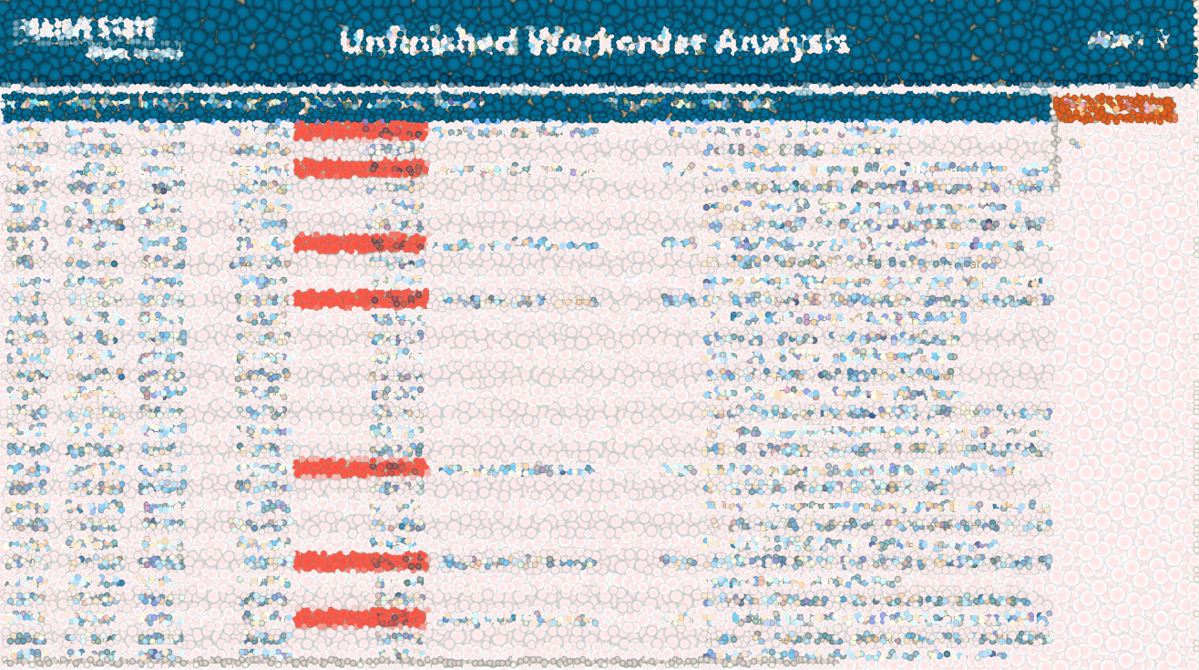
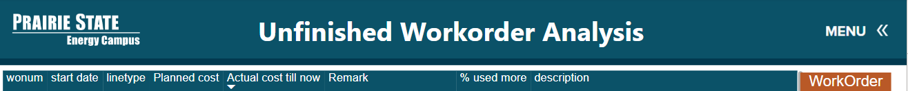
2024 Unfinished WorkOrder Analysis
Drill Through

Slide 4
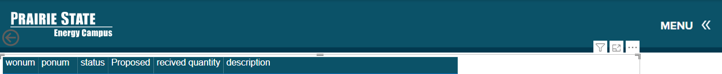

2024 Unfinished WorkOrder Analysis

Slide 5
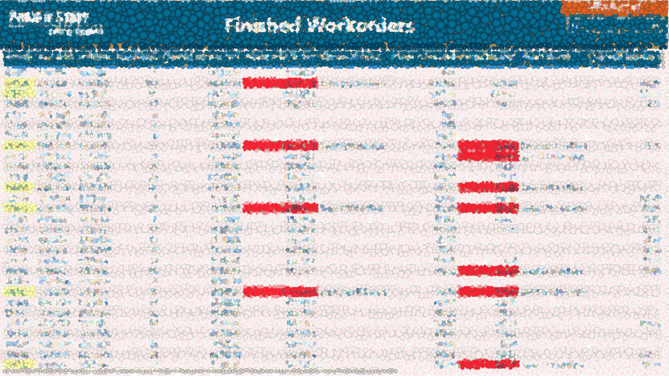
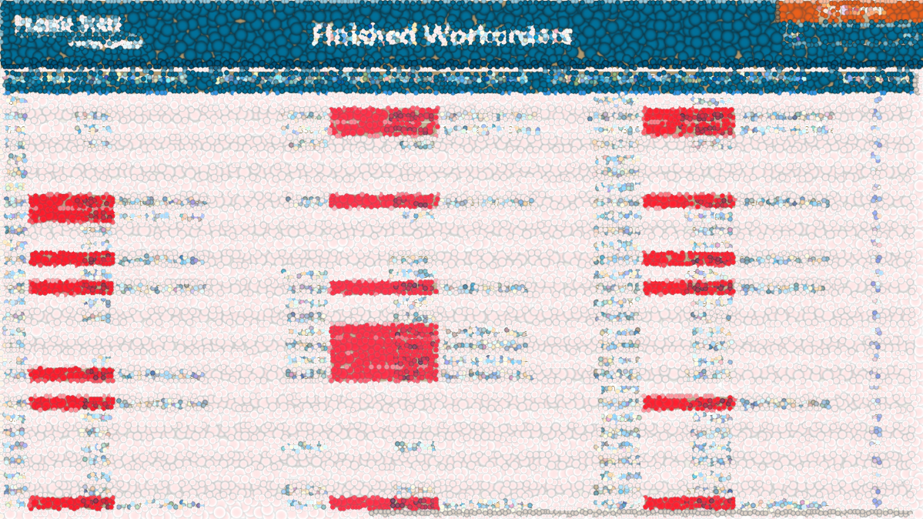
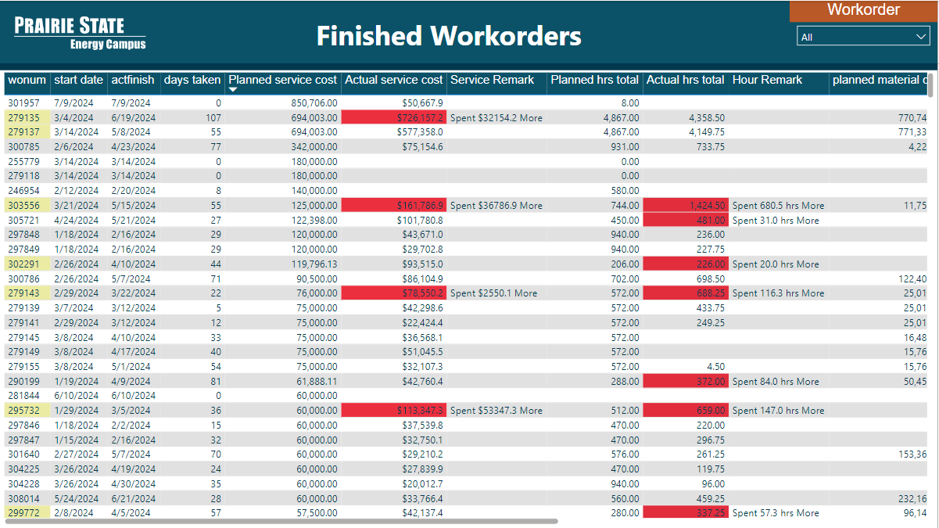
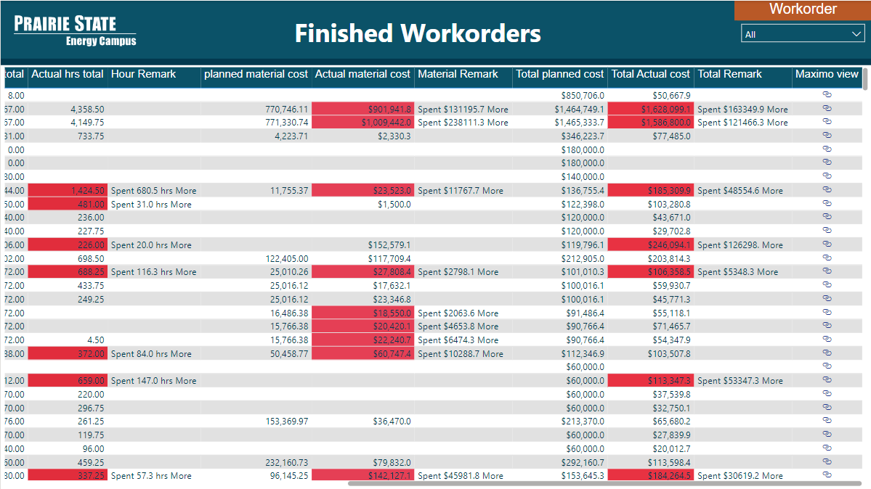
2024 Finished WorkOrder Analysis
Finished WorkOrder Analysis
Finished WorkOrder Analysis

Slide 6
2024 Finished WorkOrder Analysis
Finished WorkOrder Analysis
Finished WorkOrder Analysis

Slide 7
2024 Finished WorkOrder Analysis
Finished WorkOrder Analysis
Finished WorkOrder Analysis

Slide 8
2024 Finished WorkOrder Analysis
Finished WorkOrder Analysis
Finished WorkOrder Analysis
Drill Through

Slide 9
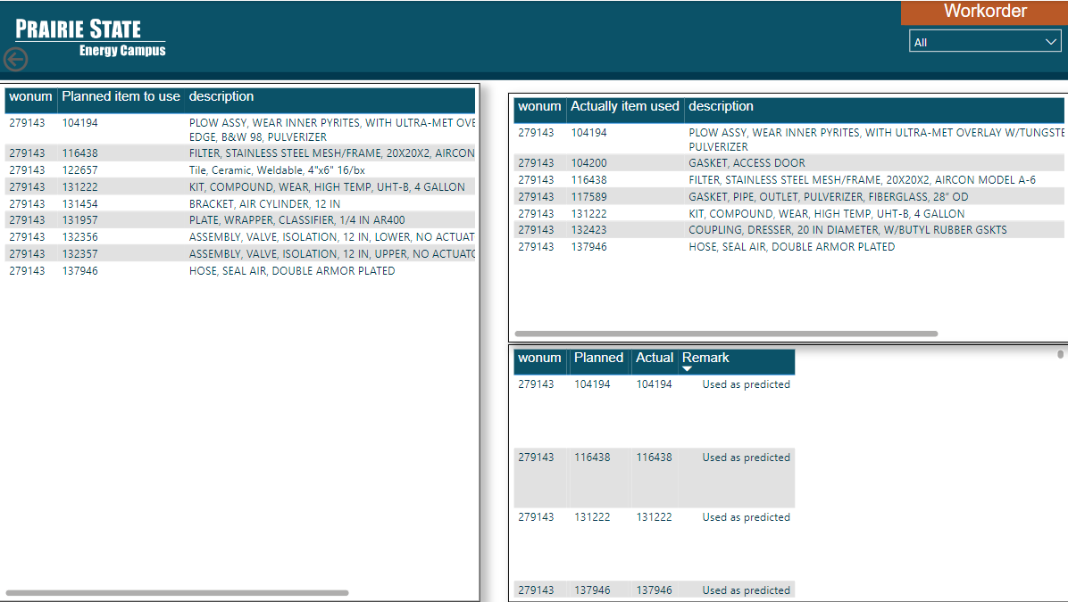
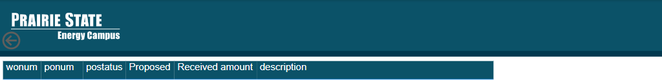

Finished WorkOrder Analysis

Slide 10



Special Thanks To:
Josh Hagene, Mackenzie Tabing, Jonathan Sander, Jeff Miller, Tom Foust Jr
Tyler Tiemann, Claire Beyes, Alyssa Lohmann
David Sohn, Dustin Wathen, Justin Gale, Melissa Weber
Randy Short and whole PSGC team.

Slide 11


